Slide 1
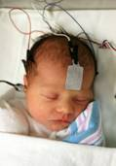

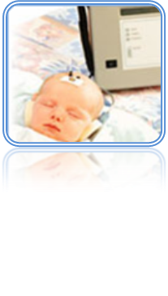
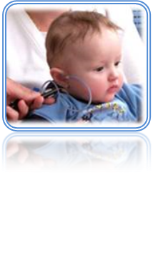
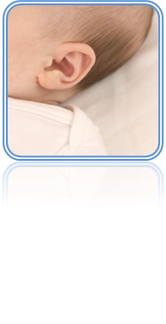
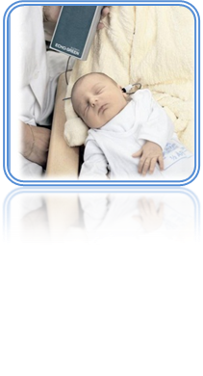
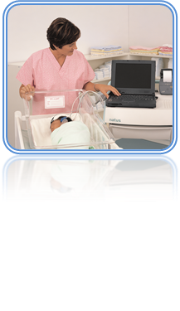
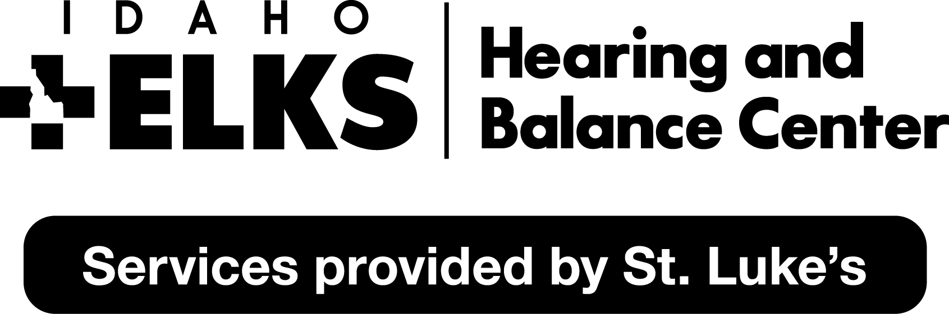
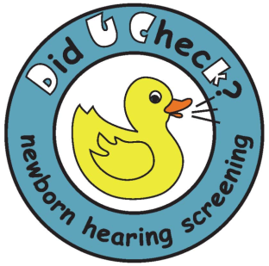
How to Engage EHDI Stakeholders in Monitoring Programs for Risk Indicators
Dr. Jessica Stich-Hennen, AuD, PASC
Specialty Certification in Pediatric Audiology
Idaho Sound Beginnings- Audiology Consultant
stichhej@slhs.org
Dr. Gabriel Bargen, PhD, CCC-A/SLP
Associate Professor
Idaho State University
barggabr@isu.edu

Slide 2
Disclaimer
I have no relevant financial relationships with the manufacturers of any commercial products and/or provider of commercial services discussed in this CME activity
I do not intend to discuss an unapproved/investigative use of a commercial product/device in my presentation

Slide 3
Learning Objectives
Participants will be able to identify the stakeholders involved with monitoring for delayed-onset hearing loss.
Participants will be able to explain options for risk monitoring protocols.
Participants will be able to describe opportunities to engage stakeholders within the monitoring process.

Slide 4
Goals of risk monitoring program
Identify infants and children at risk for delayed onset or progressive hearing loss
Timely diagnostic assessments from a pediatric audiologist
Maintain a monitoring and tracking system in the state EHDI data management system
EHDI eBook, 2015

Slide 5
EHDI program survey
Purpose of survey development: determine if EHDI programs across US and Canada monitor and track risk indicators for congenital or delayed-onset hearing loss
Data collected from October 2016-January 2017
Survey sent to:
  66 EHDI coordinators across United States
  Unknown number across Canada (11 territories)
42 responses received
  37 from US (response rate of 56.1%)
  5 from Canada (response rate of 45.5%)
Stich-Hennen & Bargen, 2017

Slide 6
EHDI program monitor risk indicators for delayed-onset and/or progressive hearing loss
Stich-Hennen & Bargen, 2017

Slide 7
Identify the stakeholders

Slide 8
Risk Monitoring Program
Birthing hospitals
& Birthing centers
Medical home
State EHDI program
Pediatric Audiology center
EHDI eBook, 2015

Slide 9
Birthing Hospital/Birthing Center roles:
Identify infants who have 1 or more risk indicators
Provide family with referral to pediatric audiology clinic
Provide family with information about risk indicators
Provide medical home information regarding risk indicator referral
Report infants with risk indicators to state EHDI program
EHDI eBook, 2015

Slide 10
Medical home roles:
Being familiar with risk factors for delayed onset hearing loss
Explaining screening results and answer questions for the family
Encourage risk monitoring follow-up
Providing family with referral to pediatric audiology clinic
EHDI eBook, 2015

Slide 11
Pediatric audiology center roles:
Providing appropriate comprehensive diagnostic testing for children with risk factors
Knowledge of risk factors that have high prevalence of delayed onset hearing loss and require early and more frequent assessments
Providing documentation regarding evaluation outcomes to state EHDI program
EHDI eBook, 2015

Slide 12
State EHDI program roles:
Providing training and support for hospitals, birthing center, physicians, and pediatric audiologists on risk factor
Providing a method for hospitals, birthing centers and pediatric audiologists to report information regarding infants with risk indicators to the state EHDI program
Tracking and surveillance of infants with risk factors
EHDI eBook, 2015

Slide 13
Risk monitoring protocols

Slide 14
Which risk indicators does your EHDI program monitor?
Stich-Hennen & Bargen, 2017

Slide 15
Do you provide state audiology clinics with guidelines for monitoring risk indicators for delayed-onset and/or progressive hearing loss (i.e. when to test, which risk indicators to monitor, how long to monitor)?
Stich-Hennen & Bargen, 2017

Slide 16
2007 JCIH Position Statement
“Infants with risk factors for hearing loss should be referred for an audiological assessment “at least once by 24-30 months of age.”
Children with risk indicators that are “highly associated with delayed onset hearing loss, such as having received ECMO or having CMV infection, should have more frequent audiological assessments.”
JCIH Position Statement 2007

Slide 17
JCIH Position Statement 2007

Slide 18
Opportunities to engage stakeholders

Slide 19

Ideas to engage stakeholders
Provide education opportunities
  Families
  Medical professionals
Provide reporting tools
  Birthing Hospitals/Birthing Center
  Audiologists
Provide program feedback

Slide 20
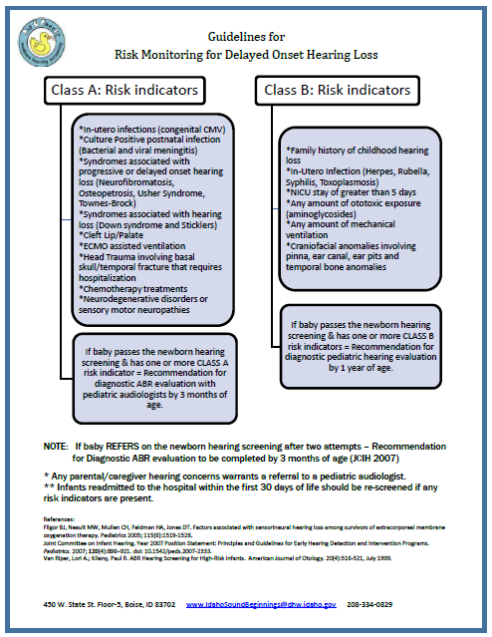
Who needs referral??

Slide 21
What do we tell the family??
“Your baby has been identified as having a risk indicator (_______) for delayed-onset or progressive hearing loss. It is recommended that any baby with (______) risk indicator has an audiological evaluation (_____) months of age. We will provide a copy of this referral form to the pediatric audiology center and they will contact you for an appointment.”

Slide 22
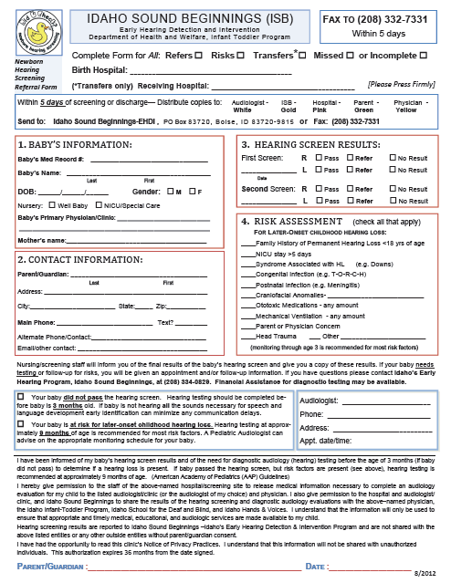
Referral forms

Slide 23
Risk indicator letters

Slide 24
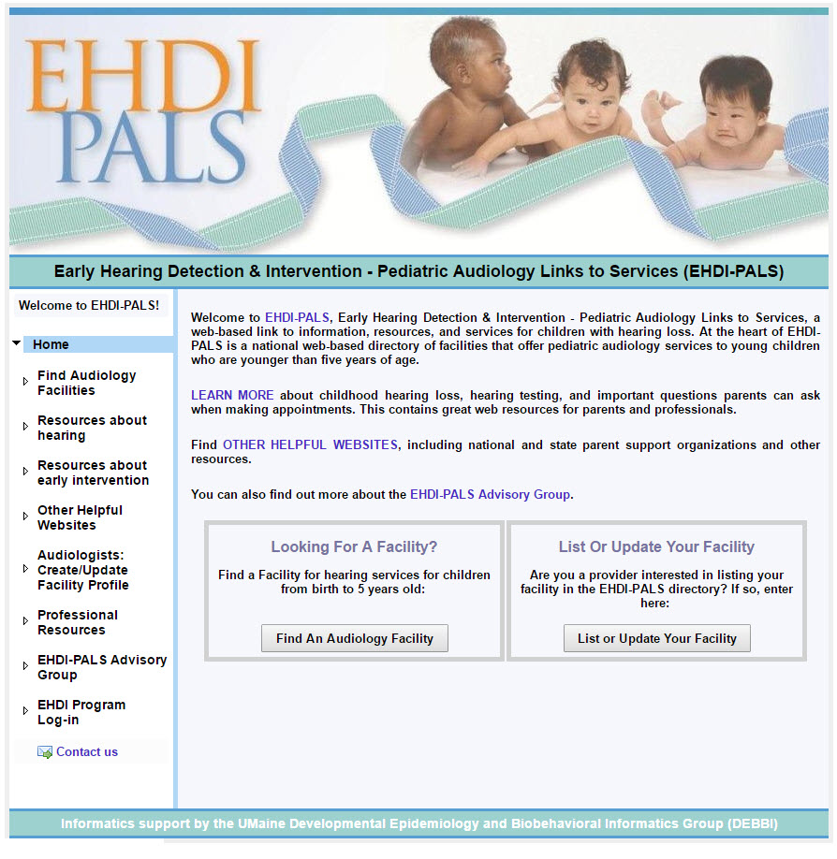
How do we find audiologists?

Slide 25
Provide guidance for testing

Slide 26
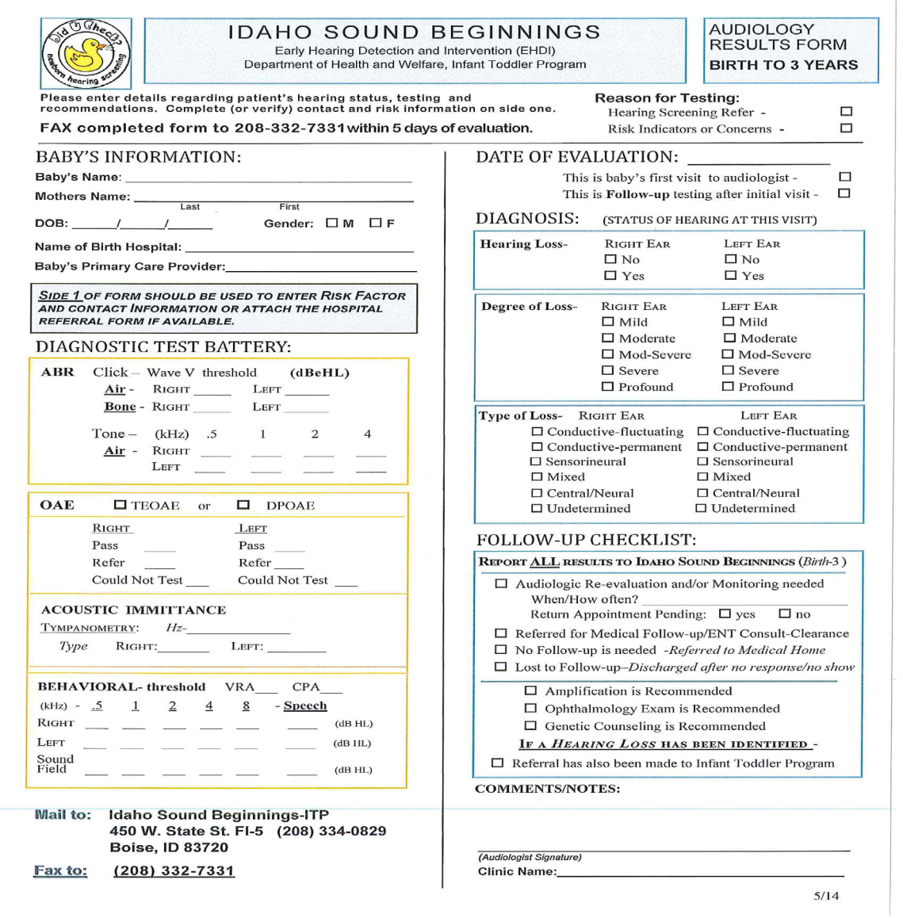
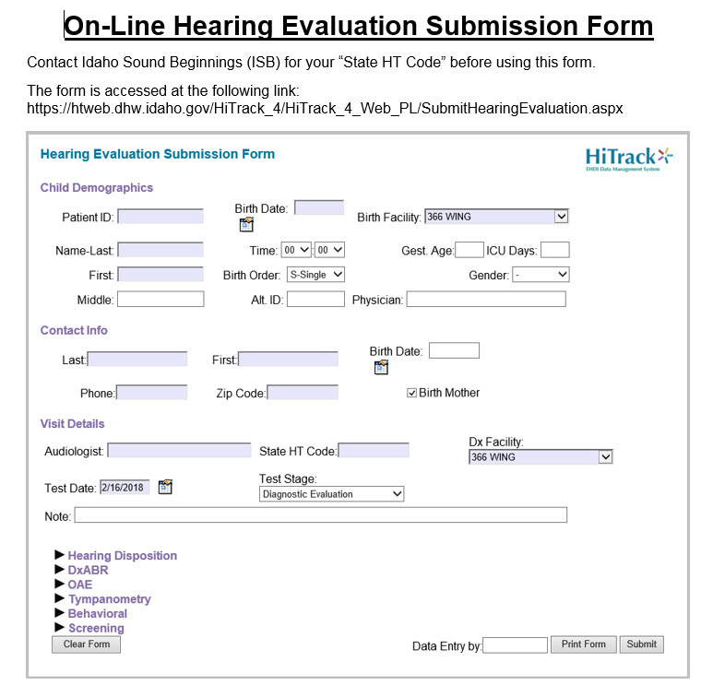
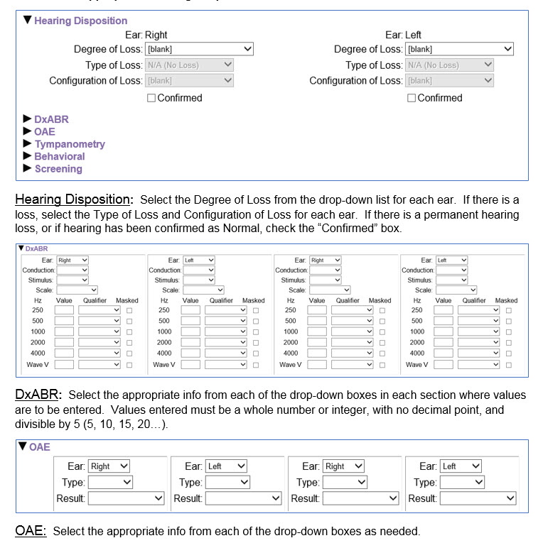
Quick and easy reporting opportunities
Paper forms Online reporting

Slide 27




Use of data management system

Slide 30
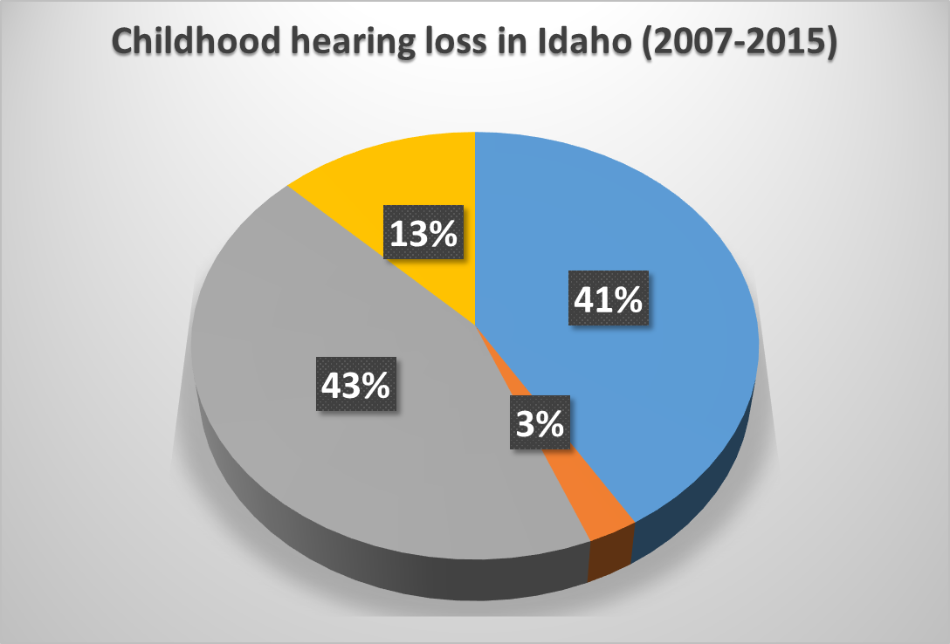
13% PASSED newborn hearing screening and had risk indicators
41% FAILED newborn hearing screening and had NO risk indicators
43% FAILED newborn hearing screening and had risk indicators
3% PASSED newborn hearing screening and had NO risk indicators

Slide 31


Slide 32
REFERENCES
Hi-Track data from Idaho Sound Beginnings Program (2007-2017).
Joint Committee on Infant Hearing (2007). Year 2007 Position Statement: Principles and Guidelines for Early Hearing Detection and Invention Programs. Pediatrics, 120: 898-921.
Stich-Hennen, J. & Bargen, G. (2017a). Survey of EHDI programs risk indicator monitoring. (Unpublished research survey). St. Luke’s Idaho Elks Hearing and Balance Centers & Idaho State University, Meridian, ID.
Stich-Hennen, J. & Bargen, G. (2017, February). EHDI programs risk indicator monitoring practices. Podium presentation at the EHDI Annual Meeting, Atlanta, GA.
Stich-Hennen, J. & Bargen, G. (2015). Risk monitoring for delayed-onset hearing loss. In L. R. Schmeltz (Ed.) The NCHAM book, Chapter 10.
Notes:
32

