Slide 1
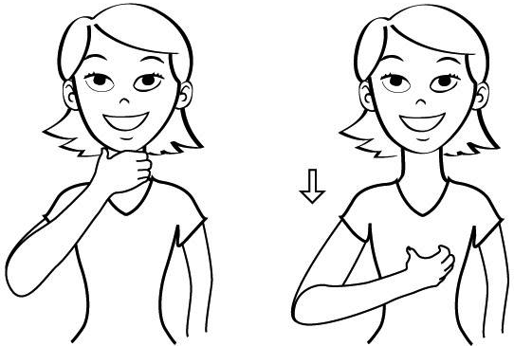
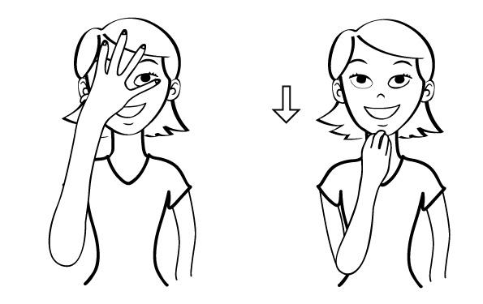
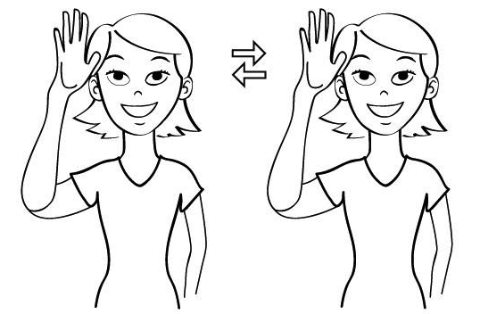
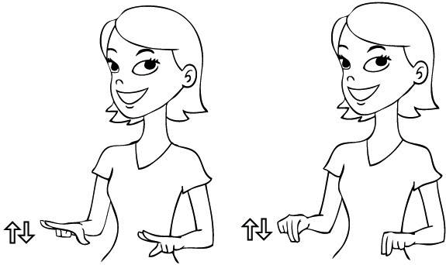
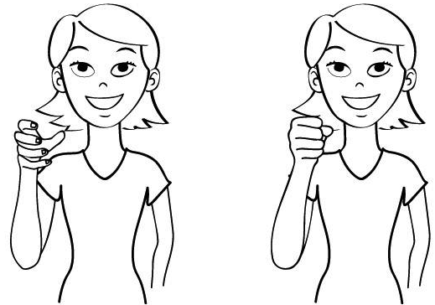
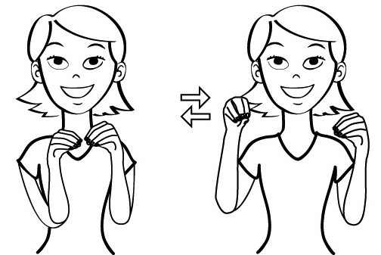
Examples of Basic Baby Signs
*Courtesy of babysignlanguage.com
Eat/Food
Hungry
Sleep
All Done
Father
Diaper
Mother
Milk
More/Again
Additional Resources
University of Washington:
ilabs.uw.edu/outreach-education
Visual Language and Visual Learning (VL2) is part of the Science of Learning Center at Gallaudet University. Excellent research briefs for educators and parents:
http://www3.gallaudet.edu/clerc-center/info-to-go/asl/summary-vl2-research-briefs.html

Slide 2
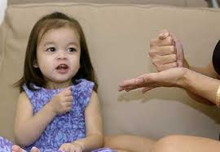
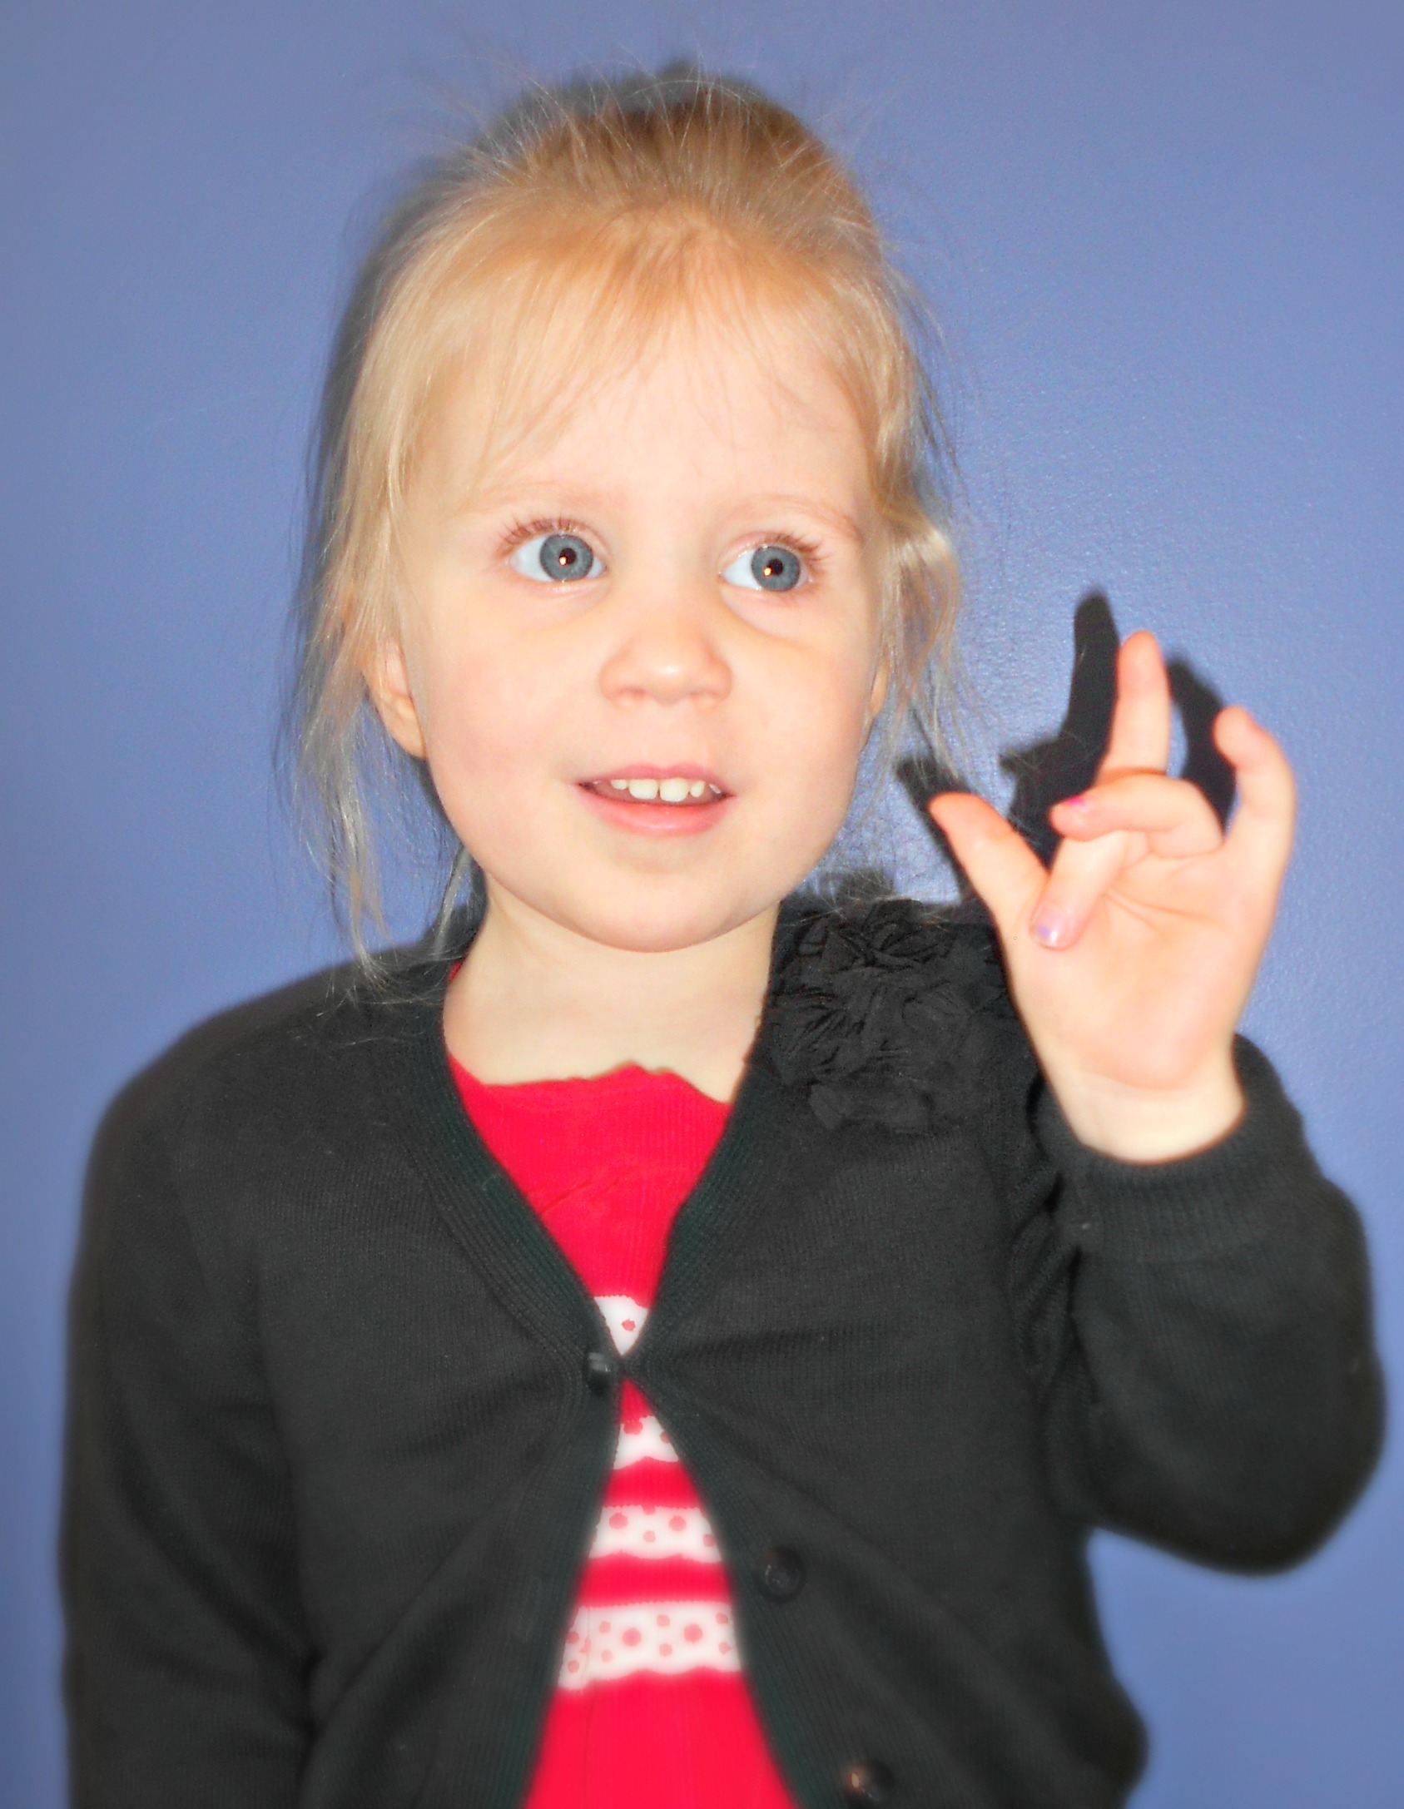
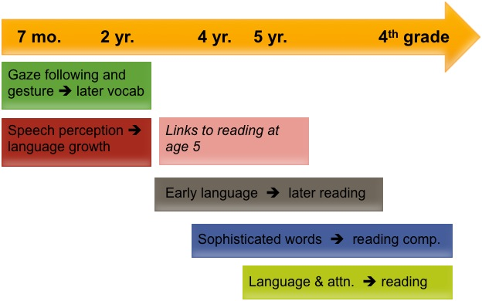
Parent-Infant Program (PIP) and The Rosen Family Preschool
Our bilingual/bimodal program supports the acquisition, learning, and use of ASL and English to meet the needs of diverse learners who are deaf and hard of hearing.
Bilingual: the development and use of two or more languages
Bimodal: the development and use of language in more than one medium
ASL is a signed language; English is a spoken and written language
Biology + Experience = Developmental Outcomes
What is the Research Telling Us?
Bilingual-Bimodal ASL/English Program
Bilingual Language Preschool Growth
Advances from brain research demonstrate that early bilingual language exposure is best for the developing Child’s brain. (Petitto, 2001, 2010)
A strong correlation exists between ASL fluency and English literacy skills. (Strong & Prinz ,1997; Prinz, 1998, 2002; Hoffmeister, 2000)
Early bilingual experiences relate to flexible thinking. (Mayberry, 2011)
Language development in the visual-gestural modality occurs on approximately the same timetable as that for spoken languages (Newport & Meier, 1985; Meier & Newport, 1990; Petitto & Marentette, 1991)
Early access to language (spoken or signed) is the best predictor of positive spoken language outcomes. (Yoshinaga-Itano & Sedey, 2000)
There is a bilingual education advantage. (National ASL/English Bilingual Early Childhood Education Advisory Group, VL2 Project; Petitto 2010)
(Brooks & Meltzoff, 2008)
(Kuhl et al., 2005; Lebedeva et al., 2010)
Guiding Principles
PIP and Rosen Family Preschool
Early accessible language—spoken or signed—is a predictor of positive language outcomes
The brain does not discriminate against language
Students will attain linguistic proficiency in ASL and written English because language supports language
Spoken English is a component to the approach
Expectations for success are high, regardless of hearing level. We carry the utmost faith in the learner

